Slide 1
May 25th, 2024 Management of Ph- B-ALL: A focus on E1910 Study ADVISORS PRE-READS
SC-GL-AMG103-00119

Slide 2
E1910 Study
ECOG-ACRIN E1910 randomized phase III national cooperative clinical trials network trial

Slide 3
Consolidation therapy with Blinatumomab improves overall survival in newly diagnosed adult patients with b-lineage acute lymphoblastic leukemia in measurable residual disease negative remission: Results from ecog-acrin e1910 randomized phase Iii national cooperative clinical trials network trial
Mark R Litzow¹, Zhuoxin Sun², Elisabeth Paietta³, Ryan J Mattison⁴, Hillard M Lazarus⁵, Jacob M Rowe⁶, Daniel A Arber⁷, Charles G Mullighan⁸, Cheryl L Willman⁹, Yanming Zhang¹⁰, Matthew Wieduwilt¹¹, Michaela Liedtke¹², Julie Bergeron¹³, Keith W Pratz¹⁴, Shira Dinner¹⁵, Noelle V Frey¹⁶, Steven D Gore¹⁷, Bhavana Bhatnagar¹⁸, Ehab L Atallah¹⁹, Geoffrey L Uy²⁰, Deepa Jeyakumar²¹, Tara L Lin²², Richard F Little²³, Selina M Luger²⁴, and Martin S Tallman²⁵
¹ Division of Hematology, Mayo Clinic, Rochester, MN; ² Dana-Farber Cancer Institute, Boston, MA; ³ Cancer Center, Montefiore Medical Center, Bronx, NY; ⁴ Carbone Comprehensive Cancer Center, Madison, WI
⁵ Adult Hematologic Malignancies & Stem Cell Transplant Section, University Hospitals Cleveland Medical Center, Shaker Heights, OH; ⁶ Department of Hematology, Shaare Zedek Medical Center, Jerusalem, Israel; ⁷ Department of Pathology, The University of Chicago, Chicago, IL; ⁸ Department of Pathology, St. Jude Children's Research Hospital, Memphis, TN; ⁹ Mayo Clinic, Rochester, MN; ¹⁰ Department of Pathology and Laboratory Medicine, Cytogenetics Laboratory, Memorial Sloan Kettering Cancer Center, New York, NY; ¹¹ Stephenson Cancer Center, University of Oklahoma Health Sciences Center, Oklahoma City, OK; ¹² Department of Medicine, Divisions of Oncology and Hematology, Stanford University, Stanford, CA; ¹³ CEMTL installation Maisonneuve-Rosemont, Montreal, QC, Canada; ¹⁴ Department of Medicine, Hematology-Oncology Section, Hospital of the University of Pennsylvania, Philadelphia, PA; ¹⁵ Robert H. Lurie Comprehensive Cancer Center, Northwestern University, Chicago, IL; ¹⁶ Abramson Cancer Center, University of Pennsylvania, Narberth, PA; ¹⁷ Cancer Therapy Evaluation Program, National Cancer Institute, Bethesda, MD; ¹⁸ Department of Hematology and Medical Oncology, West Virginia University Cancer Institute, Wheeling, WV; ¹⁹ Division of Hematology/Oncology, Medical College of Wisconsin, Milwaukee, WI; ²⁰ Division of Oncology, Department of Medicine, Washington University School of Medicine, Saint Louis, MO; ²¹ Division of Hematology/Oncology, UC Irvine Medical Center, Orange, CA; ²² University of Kansas, Westwood, KS; ²³ National Cancer Institute, Washington, DC; ²⁴ Cellular Therapy and Transplantation, Abramson Cancer Center of the University of Pennsylvania, Philadelphia, PA; ²⁵ Robert H. Lurie Comprehensive Cancer Center, Northwestern University and ECOG, Chicago, IL

Slide 4
Background
Patients with newly diagnosed acute lymphoblastic leukemia (ALL) often relapse even after achieving complete remission (CR) and minimal residual disease negative (MRD-) status after chemotherapy
E1910 was a phase III trial for Philadelphia-negative ALL pts 30-70 years that randomized to chemotherapy +/- blinatumomab to test whether blin improves outcomes
Subjects received 2.5 months of BFM-type induction modified from E2993/UKALLXII
Subjects who achieved CR/CRi received CNS intensification with high-dose methotrexate and pegaspargase
MRD was evaluated and subjects were randomized to 4 cycles of chemotherapy +/- four 28 day cycles of blinatumomab followed by 2.5 years of POMP maintenance timed from the start of intensification

Slide 5
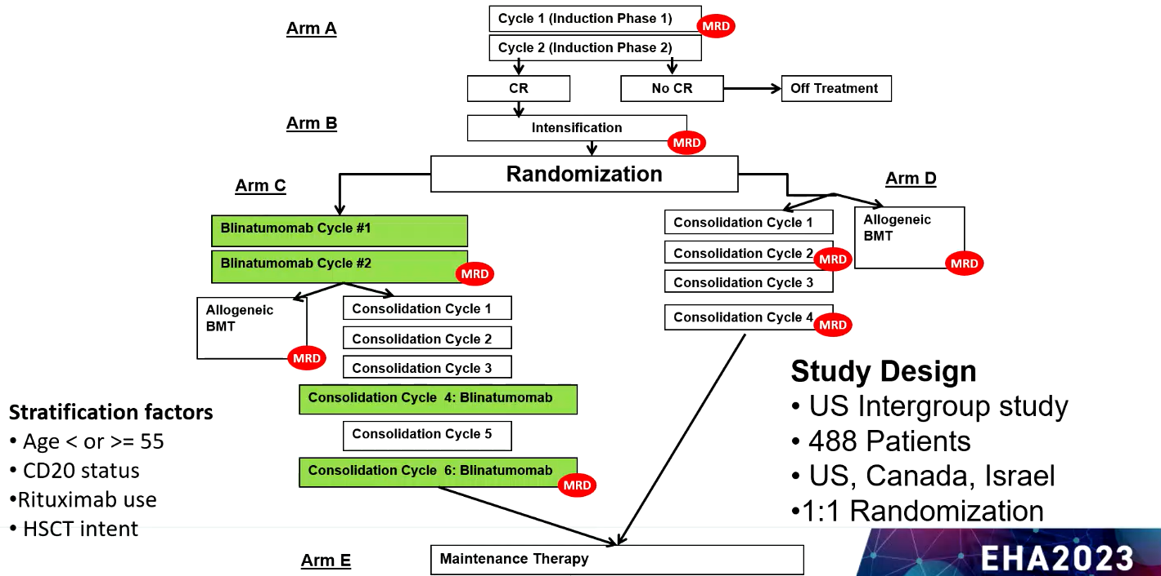
E1910: Randomized Phase 3 adult frontline ALL

Slide 6
Methods
Measurable residual disease status was determined by 6 color flow cytometry at the ECOG-ACRIN Leukemia Translational Research Lab with >= 0.01% as the cutoff for positivity
With a minimum of 190 MRD-negative patients, the study had an 80% power to detect a 45% reduction in hazard rate in the blinatumomab arm compared to the control arm using one-sided log rank test at significance level of 0.025 and assuming 2 years of follow up
Estimates of overall survival were calculated using the Kaplan-Meier method
Comparison of overall survival between treatment arms was conducted using stratification factors of:
Age
CD20 status
Rituximab use
Intention or not to receive hematopoietic cell transplant

Slide 7
Results
Study Activation: December 2013
Study Termination: October 2019
772 pts were screened, 488 were enrolled
Median age 51 years
CR/CRi rate after induction was 81%
224 MRD-negative pts were randomized, 112 in each arm
22 pts in each arm proceeded to allogeneic HCT
After blin approval for MRD+ in March 2018, MRD+ subjects were no longer randomized, but assigned to Arm C
No new safety signals were noted

Slide 8
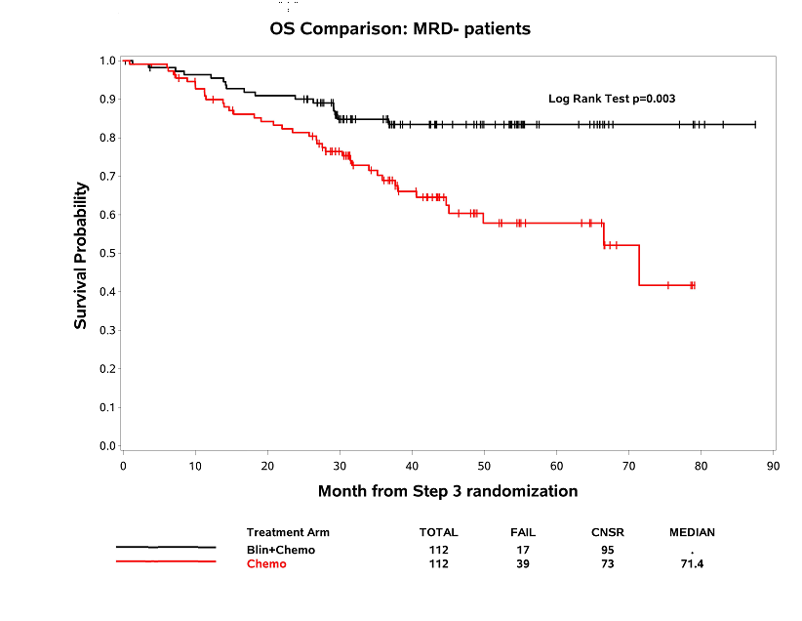
Results
OS for MRD-negative patients (presented at ASH 2022)
Median OS: not reached (Blin+Chemo) vs 71.4 mos (Chemo);
Hazard ratio 0.42, 95% CI: 0.24-0.75,
Log rank test, p=0.003

Slide 9
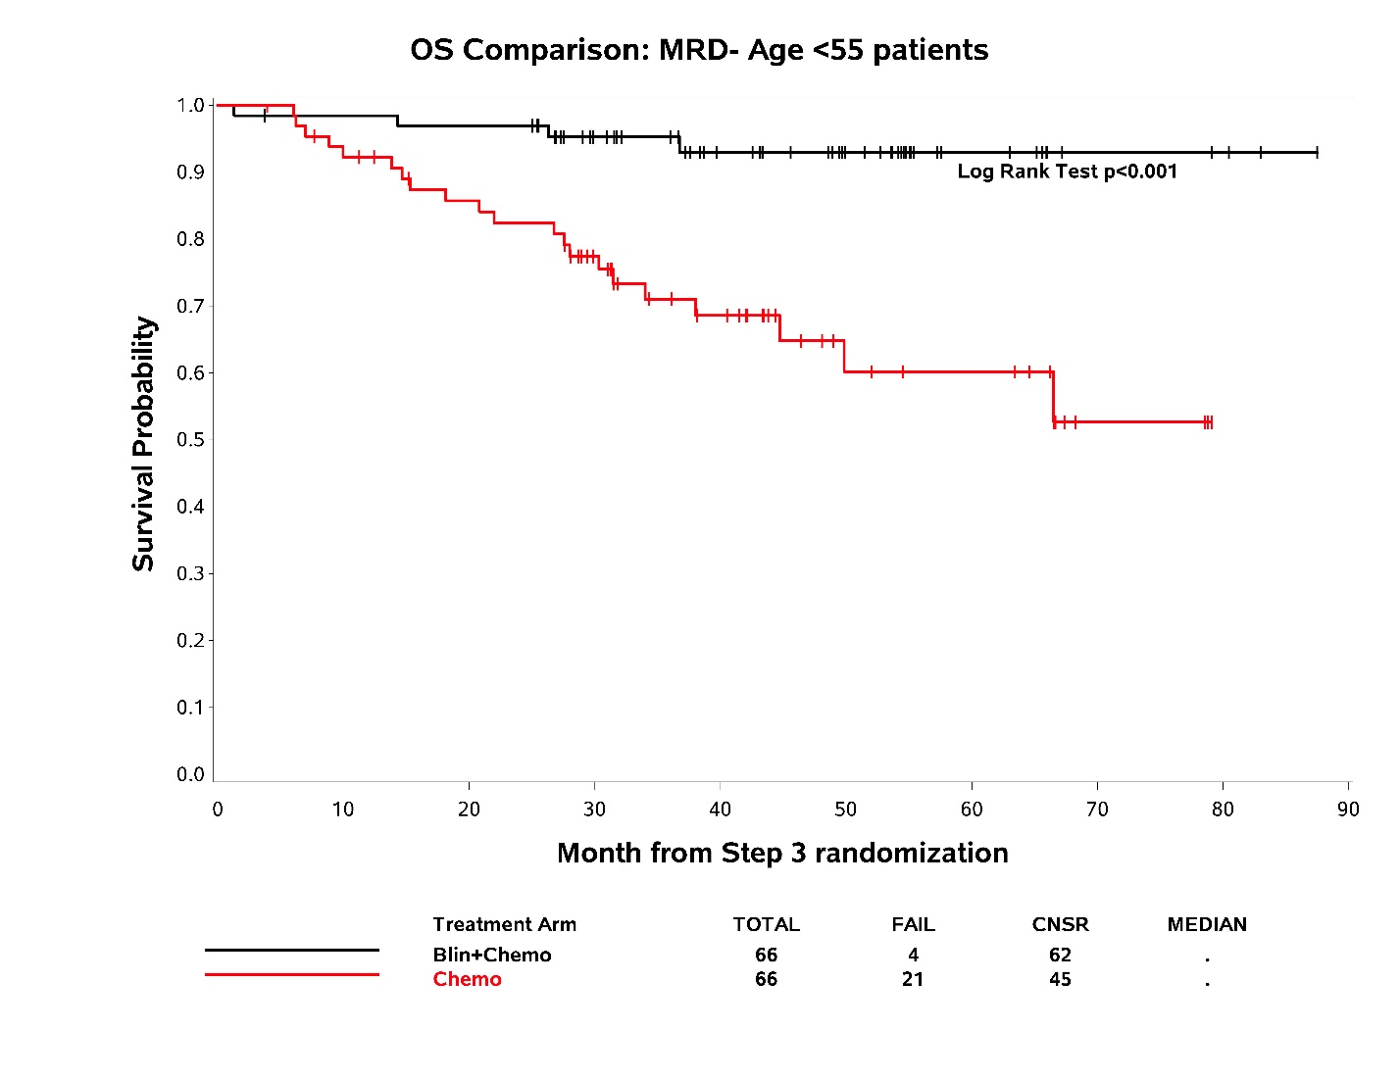
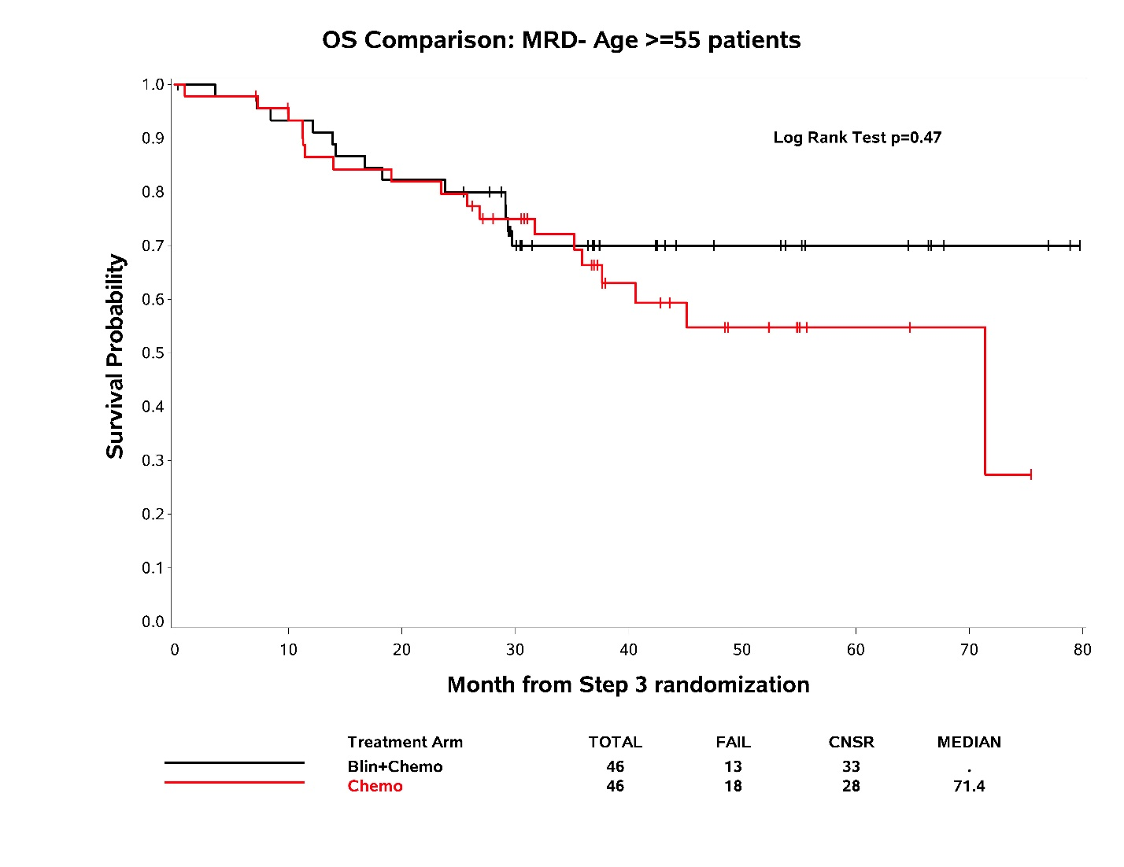
Results
OS for MRD-negative patients stratified by age < 55 years or >= 55 years
Median OS not reached both arms; HR 0.18, 95% CI: 0.06-0.52, p<0.001
Median OS NR vs 71.4 months, HR 0.77, 95% CI: 0.37-1.58, p=0.47

Slide 10
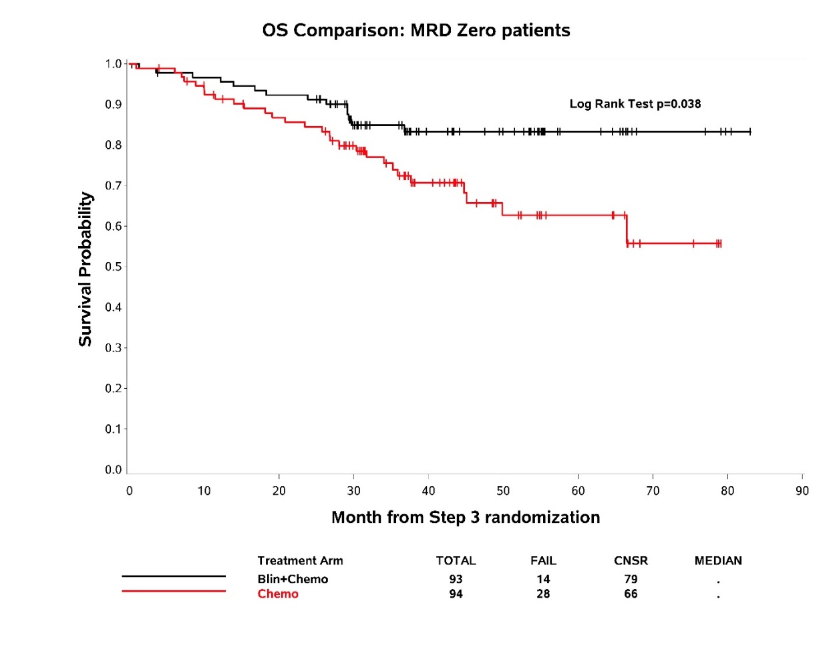
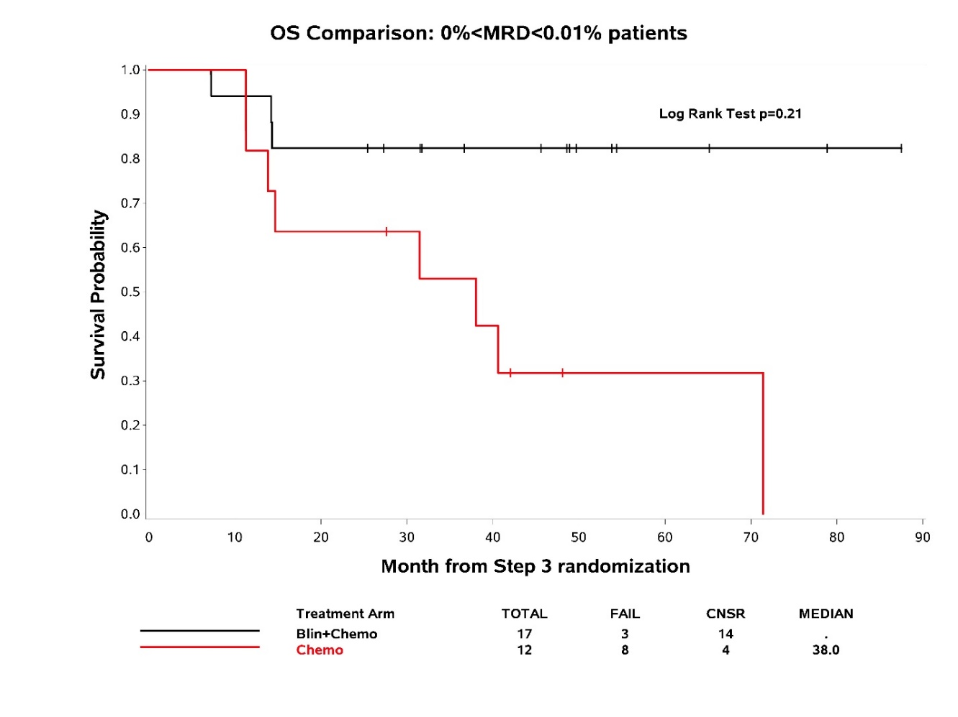
Results
OS for undetectable MRD at randomization and for those between undetectable and 0.01%
Median OS not reached both arms; HR 0.51, 95% CI: 0.27-0.97, p=0.038
Median OS NR vs 38.0 months, HR 0.35, 95% CI: 0.06-1.94, p=0.16

Slide 11
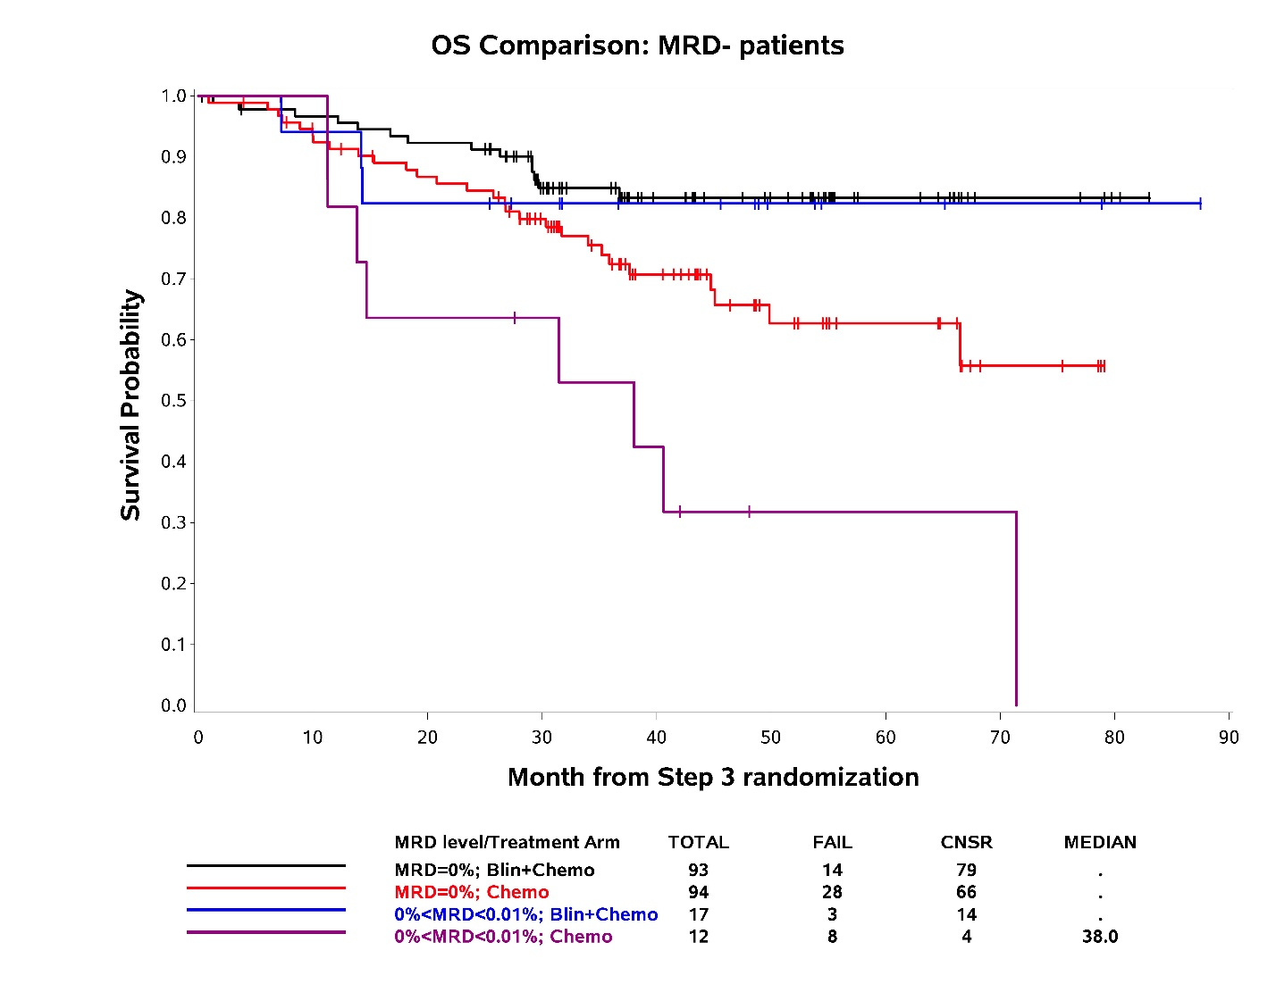
Results
OS for MRD < 0.01% by MRD level and by whether or not blinatumomab was given

Slide 12
Summary/Conclusion
Adding blinatumomab to chemotherapy improves overall survival in patients who are MRD-negative at randomization (using cutoff of 0.01%)
Blinatumomab provided the clearest overall survival benefit to patients < 55 years
Patients with undetectable MRD (0%) had improved overall survival with blinatumomab
Patients with MRD between undetectable (0%) and 0.01% had survival benefit with blinatumomab, but subset numbers were too small to show definitive effect

